Slide 1
Geospatial Data Management Final Project
Simone Laudani

Slide 2
Scenario
Geospatial data points logging during my visit in Berlin Using the phone app: GPSLogger
https://gpslogger.app/

Slide 3
Data scheme
Geometry with reference system: EPSG:4326 WGS 84
Time: UTC + timezone
Transportation mean: still, walk, bike, car
Interval of acquisition set to 1 minute

Slide 4
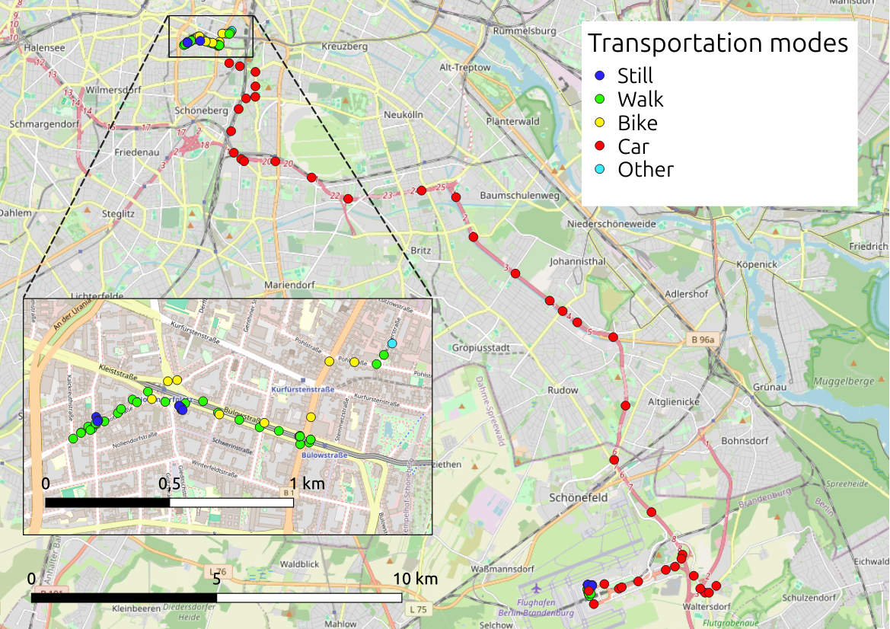

Slide 5
Objective
To infer transportation means for each data point,and getting the lowest possible error
Measuring the error ratio:
Error = number incorrect predictions / total points number

Slide 6
Data preprocessing
Create a new table with selected attributes:
CREATE TABLE gps_20250520_processed AS (SELECT ogc_fid AS id, wkb_geometry, time, mode, src, LAG(wkb_geometry) OVER (ORDER BY time) AS prev_geom, LAG(time) OVER (ORDER BY time) AS prev_time FROM gps_20250520_original ORDER BY time);
Using prev_geom and prev_time fields to compute the spatial and temporal distances between two consecutive points
And then get the speed between the current and the previous point

Slide 7
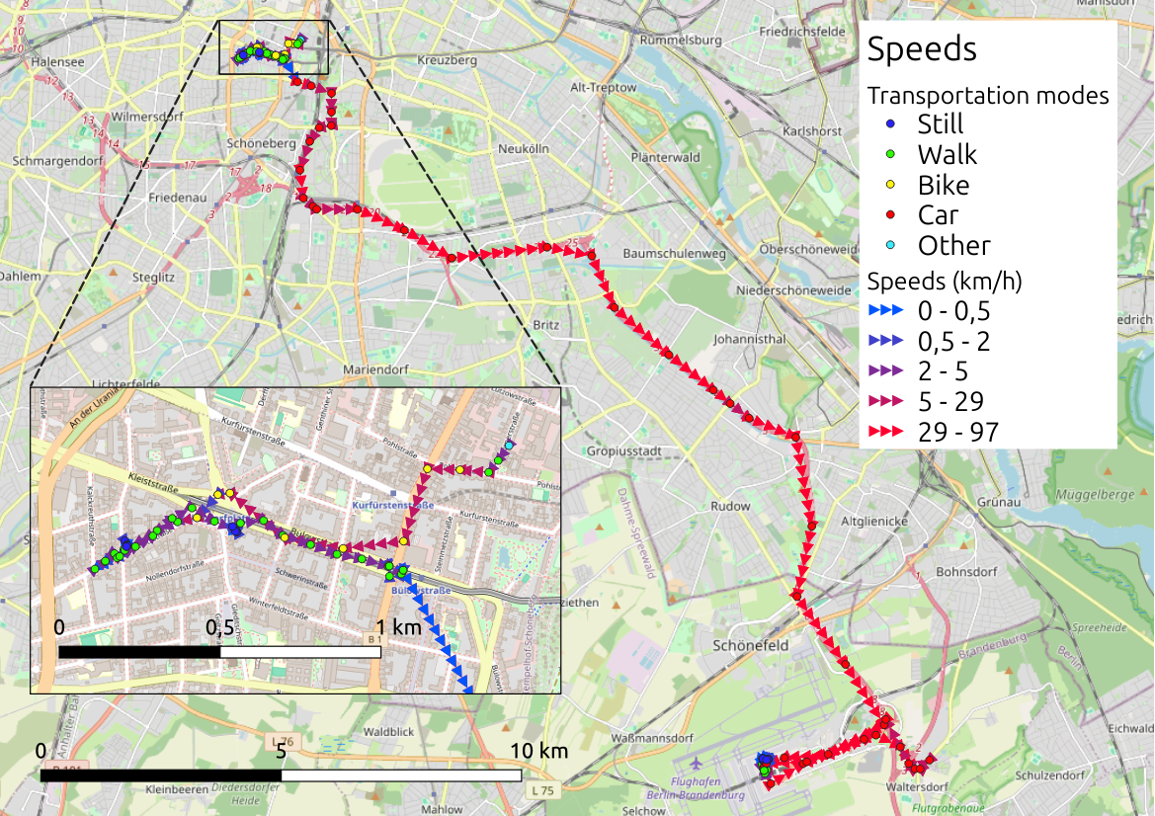

Slide 8
Statistics

Slide 9
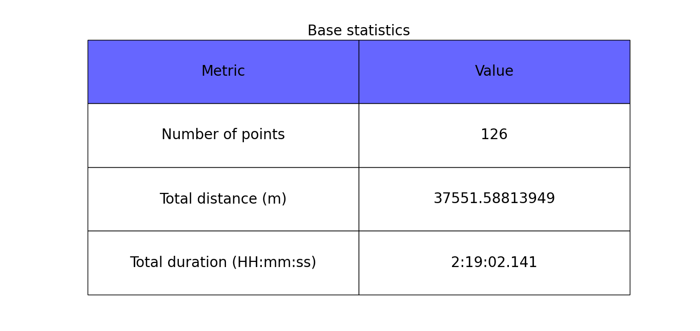

Slide 10
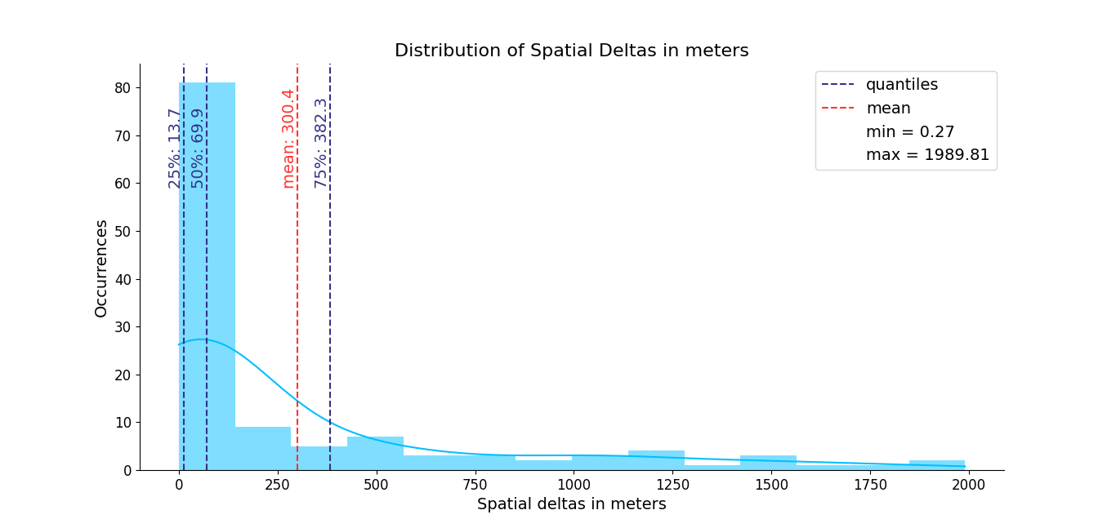

Slide 11
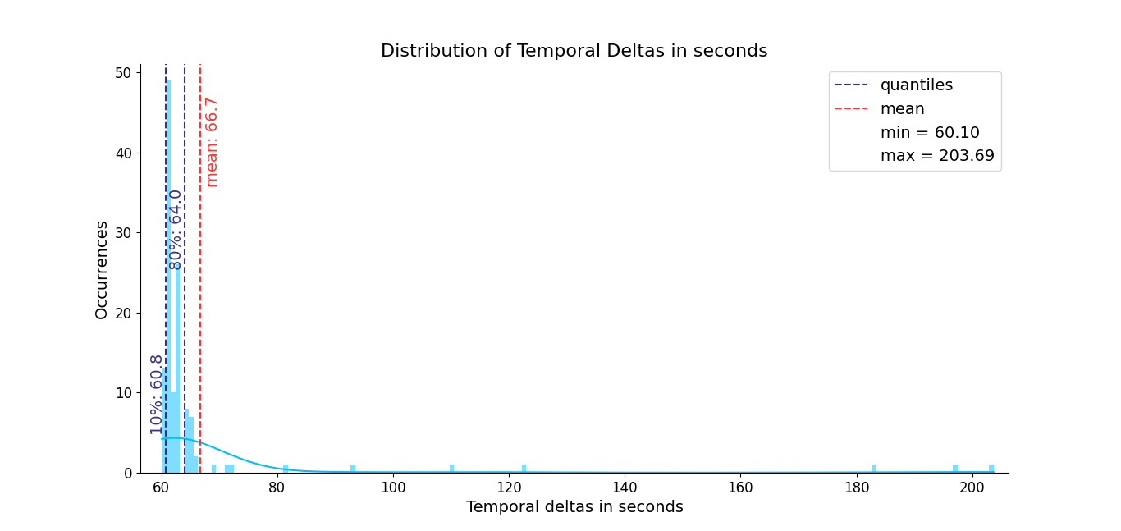

Slide 12
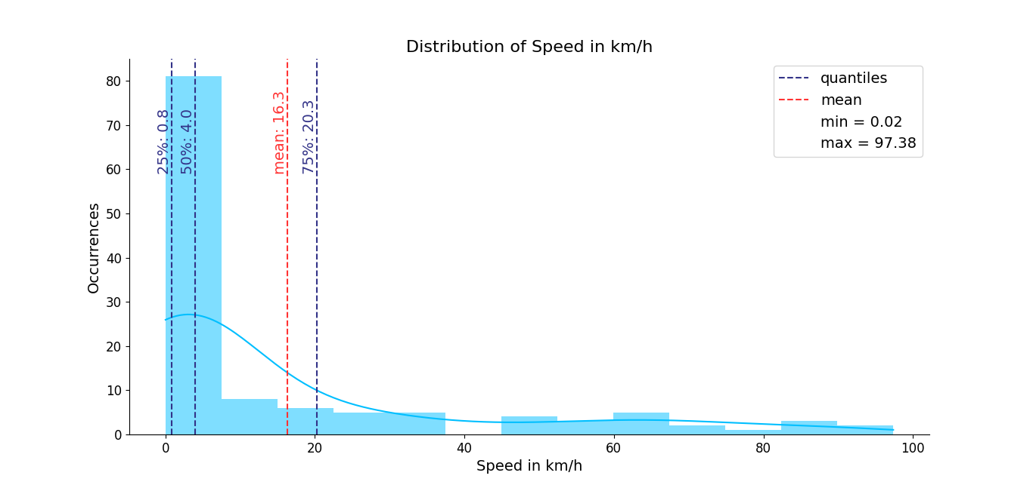

Slide 13
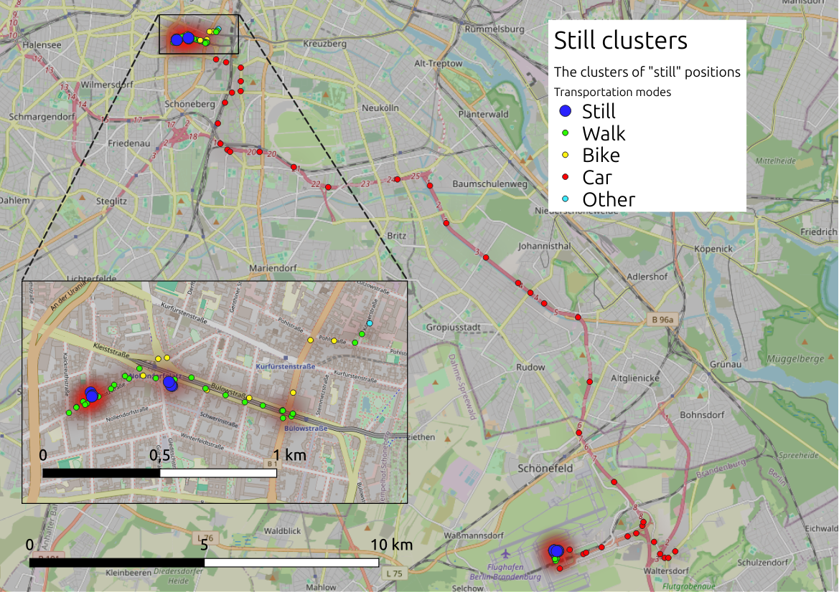

Slide 14
Solving approach
Python script to do a random search on range values:
thresholds = {
'still-walk': np.arange(0, 5, .01),
'walk-bike': np.arange(5, 10, .01),
'bike-car': np.arange(10, 20, .01)
}
Updating the values on the data points table and comparing to the ground truth to find the minimal error ratio
https://github.com/simone-05/gdm_project/blob/main/random_search_with_csv.py

Slide 15
Results

Slide 16
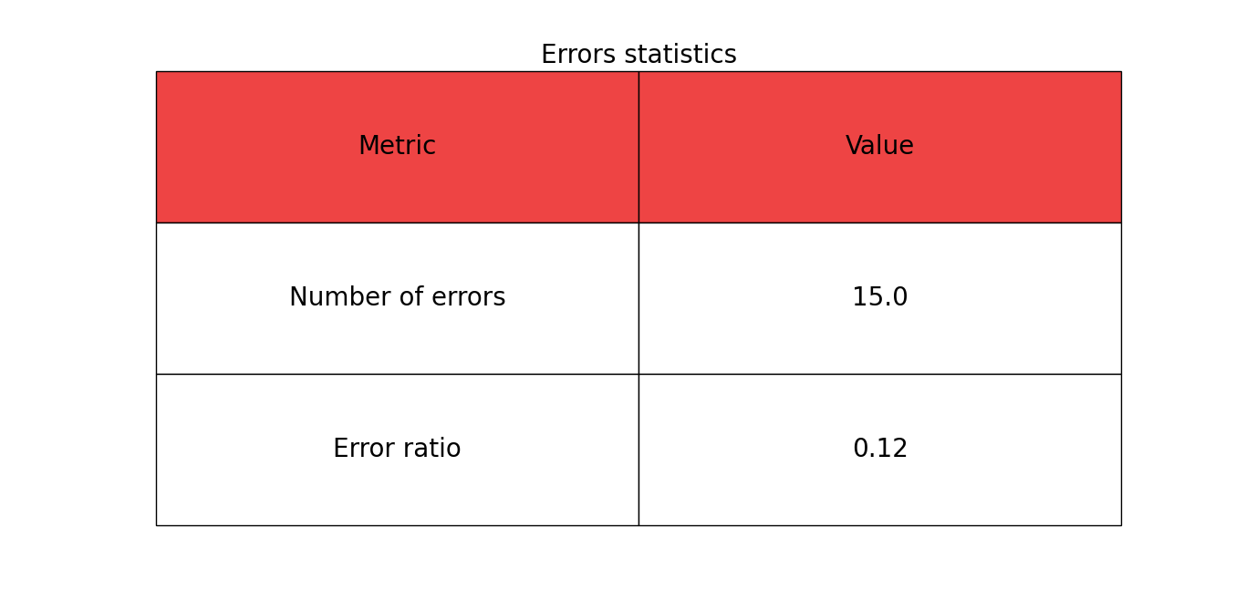

Slide 17
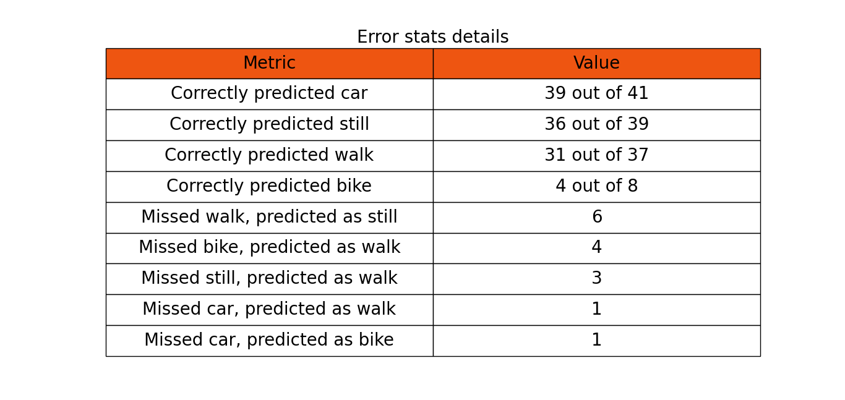

Slide 18
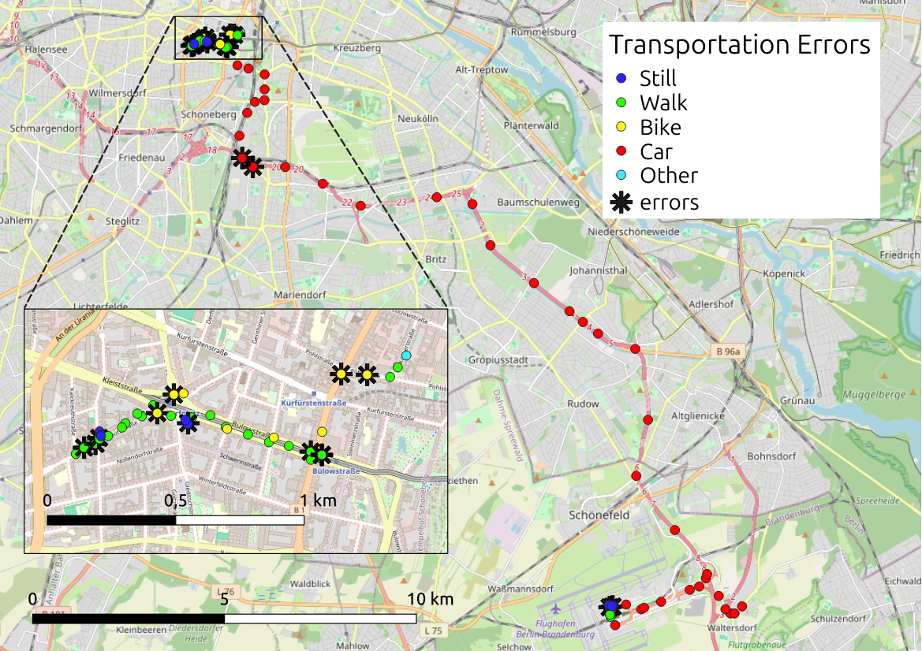

Slide 19
End

